Slide 1



FOR TONIES
CASE STUDY – Playback Data
Analysis and Recommendations
Raj Pravin Rajendran
01/07/2024

Slide 2




ABOUT ME
Business Intelligence Analyst at Liberty Global
Portfolio
Raj Pravin Rajendran
Git Hub

Slide 3
Data Definition and EDA
Definition
EDA
Total minutes played 7550106.65
Dates between 2021-12-16, 2023-06-06
Total days 537
Total Unique tonie boxes 892
Total Unique tonie figures 10351
Hours played between 0 23
Total tonie type
CONTENT - 353118
CREATIVE - 59296
The dataset provides detailed usage data for Toniebox devices, including play duration, play times, and activation details for various Tonie figures.
01
02
Growth Analyst Data
Installs
It includes unique identifiers for both the devices and figures, along with timestamps for different activities
This information is useful for analyzing user engagement and retention patterns. The data can identify high engagement periods and user preferences based on play start hours and total play seconds..

Slide 4
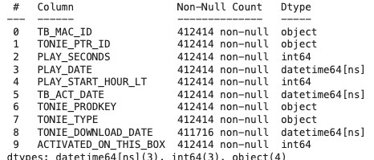


Data Cleaning and Preparation:
Data types
From the image we can find all the columns are in right data type hence we don’t have to change it
DUPLICATES
NULL VALUES
0 Duplicates
CONTENT_TYPE – 52001
content_type – 412414
TONIE_DOWNLOAD_DATE - 698
Impact of Duplicate Data :
Duplicate data causes incorrect aggregation values.
This can lead to inaccurate insights and poor decision-making.
Action Taken : Duplicates Values are already 0
Impact of Null Values :
Null values can cause incomplete and misleading analysis.
Missing data can lead to inaccurate metrics and hinder the decision-making process.
Key insights might be missed due to gaps in the data.
Action Taken :
Removed the column Content_type since it is not required.
Didn’t do anything in the column TONIE_DOWNLOAD_DATE since we are not gonna use this column to make analysis.

Slide 5
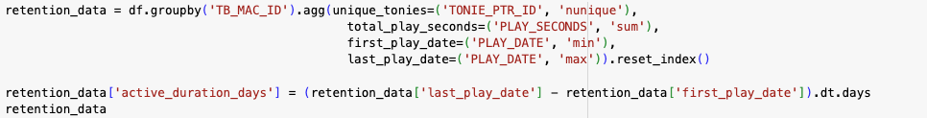
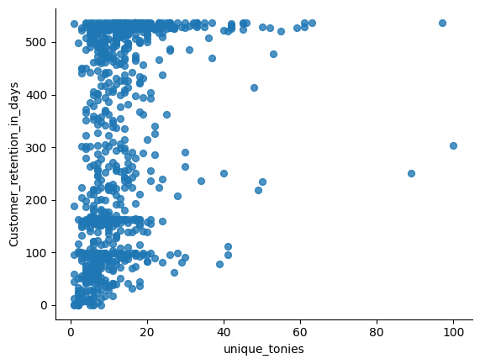
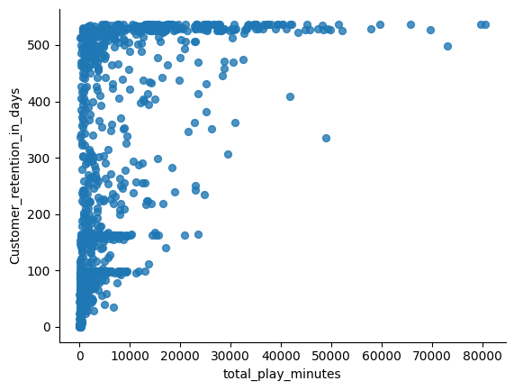
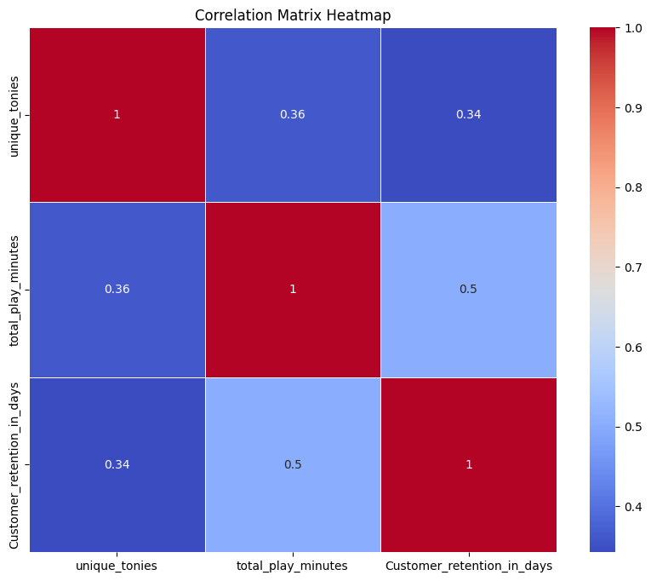
1. Is the number of tonie figures, number of minutes played, or certain tonies figures a good indicator of long-term retention (to play)?
Aggregated the data by ‘TB_MAC_ID’- Tonie box ID, counted the total unique_tonies, sum the total_play_seconds,
found the minimum date in first_play_date, found the maxmimum date in last_play_date.
With the help of the first_play_date and last_play_date found the total no of days active_duration_days that a tonie box is played
Number of unique tonie figures
Most data points are clustered around the lower range of unique_tonies, indicating that a majority of users have a relatively small number of unique Tonie figures.
There are fewer data points as the number of unique Tonies increases, with some users having a very high number of unique Tonies.
The plot shows a general trend where users with more unique Tonies tend to have a higher number of active days. However, the correlation does not appear to be very strong.
Many users with low numbers of unique Tonies have a wide range of Customer_retention_in_days.
Weak Indicator: The plot suggests that while there is a trend where users with more unique Tonies tend to have higher active duration days, this relationship is not strong enough to consider it a definitive indicator.
Number of minutes played
Most data points are clustered around the lower range of total_play_seconds and Customer_retention_in_days .
There are a few outliers with very high total_play_seconds, indicating some users play significantly more than others.
There is a visible ceiling effect on the Customer_retention_in_days axis around 500 days, indicating a maximum duration tracked or possible.
There seems to be a positive correlation between total_play_seconds and Customer_retention_in_days to some extent, as users with higher total play seconds tend to have more active days. However, the correlation does not appear to be very strong. Many users with low total_play_seconds have a wide range of Customer_retention_in_days
Moderate Indicator: The plot shows that while there is a general trend where users with higher total play seconds tend to have a higher number of active days, it is not a definitive or good indicator. There are users with low playtime who still have a high number of active days.
Unique Tonies and Retention: The correlation between unique_tonies and Customer_retention_in_days(0.34) suggests that having more unique Tonies is somewhat indicative of longer-term retention, but it is not a strong indicator.
Playtime and Retention: The correlation between total_play_seconds and Customer_retention_in_days(0.5) is moderate, indicating that total playtime is a better, though still moderate, indicator of long-term retention.

Slide 6
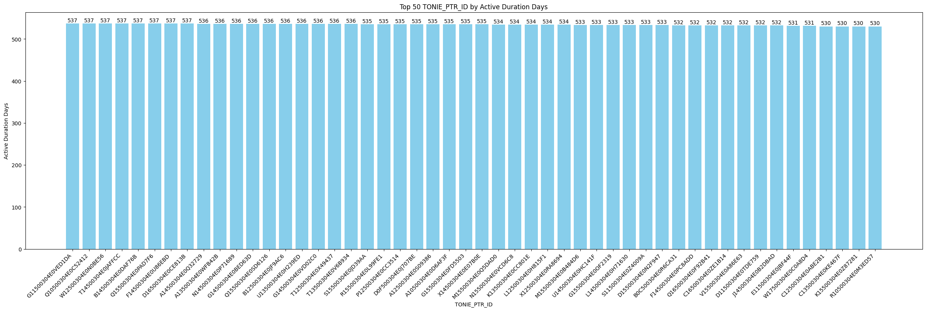
The provided bar chart displays the top 50 TONIE_PTR_ID by active_duration_days. Each bar represents a specific Tonie figure and its associated number of active days.
High Active Duration Days:
All Tonie figures in the top 50 have active duration days exceeding 530 days, with most clustering around 537 to 530 days. This indicates a high level of engagement and retention for these particular figures.
Top Performers:
The top-performing Tonie figures (G150304E0VED1DA, Q150304E6C51242, etc.) have the highest active duration days, consistently hitting the upper limit of the recorded duration (537 days).
Strong Indicator: The chart suggests that certain Tonie figures are indeed strong indicators of long-term retention. The fact that the top 50 Tonie figures all have high and consistent active duration days implies that users who possess these figures tend to stay engaged for longer periods.

Slide 7
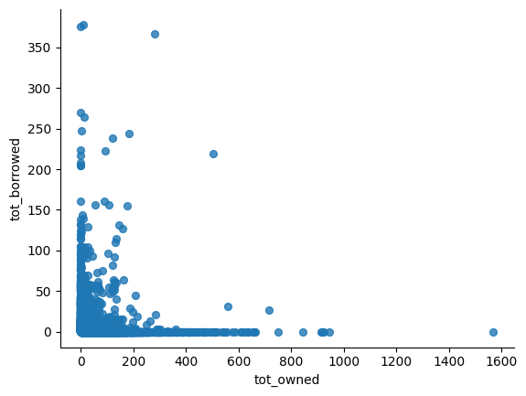
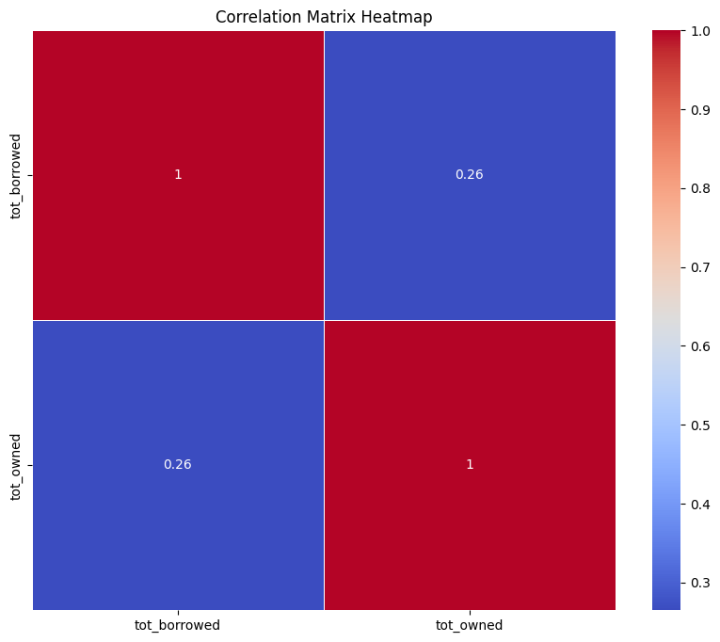
2. Do customers that played a borrowed tonie, still buy as many tonies as other customers over their lifetime?
Most data points are clustered near the lower range of both axes, indicating that the majority of users own
and borrow a relatively small number of Tonie figures.
2. Some users have borrowed a large number of Tonies (over 300) but own relatively few (under 100).There are users who own a large number of Tonies (up to 1600), but have borrowed relatively few, indicating that heavy owners are less likely to borrow.
3. Additionally, if you look at the heatmap graph it clearly says that the correlation is 0.26 which is not the stronger one.
4. There appears to be an inverse relationship between the number of Tonies borrowed and owned. As ownership increases, the number of borrowed Tonies decreases.
Recommendations
Targeted Marketing for Borrowers:
Develop targeted marketing campaigns to convert customers who frequently borrow Tonies into buyers.
Highlight the benefits of owning Tonies, such as exclusive content or special features.
Offer special promotions or discounts for customers who have borrowed a certain number of Tonies to encourage them to purchase their own.

Slide 8
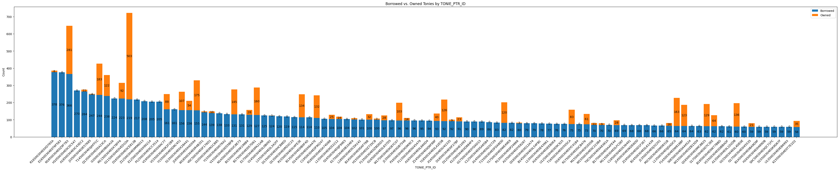
By examining the top 100 IDs sorted by the number of borrowed Tonies, we observe that only a few individuals who borrow Tonie figures also own them. Therefore, we cannot conclude that borrowing Tonies is a reliable indicator of future purchases.
2. we should tailor marketing campaigns specifically for those who frequently borrow but purchase infrequently, aiming to convert these borrowers into owners of Tonie figures.
Conclusion : Customers who play borrowed Tonies generally do not buy as many Tonies as those who borrow less or none at all. The scatter plot shows a clear trend where higher borrowing is associated with lower ownership. While borrowing Tonies does not completely prevent users from purchasing them, it appears to be associated with a lower number of purchases. This insight can be used to develop strategies to convert borrowers into buyers, possibly through targeted marketing or incentive programs.

Slide 9
Q and A????

